Slide 1
HADOOP ARCHITECTURE AND ECOSYSTEM
Prepared by,
J.Gladys Aani Sujitha,
AP/CSE.

Slide 2
Hadoop is an open source framework from Apache and is used to store process and analyze data which are very huge in volume.
It is used for batch/offline processing.It is being used by Facebook, Yahoo, Google, Twitter, LinkedIn and many more. Moreover it can be scaled up just by adding nodes in the cluster.

Slide 3
Hadoop Ecosystem
Hadoop Ecosystem is a platform or a suite which provides various services to solve the big data problems.
It includes Apache projects and various commercial tools and solutions.
There are four major elements of Hadoop i.e. HDFS, MapReduce, YARN, and Hadoop Common Utilities.
Most of the tools or solutions are used to supplement or support these major elements.
All these tools work collectively to provide services such as absorption, analysis, storage and maintenance of data etc.

Slide 4
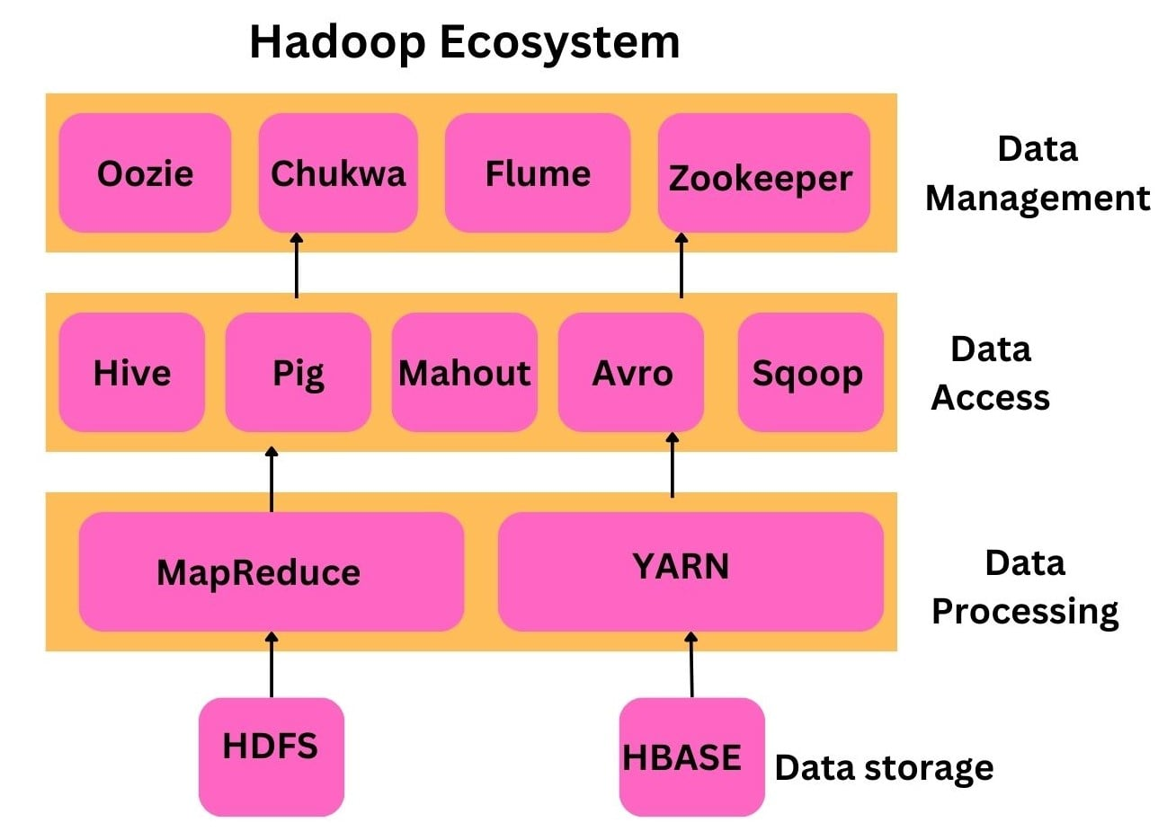

Slide 5
Modules of Hadoop
HDFS: Hadoop Distributed File System. Google published its paper GFS and on the basis of that HDFS was developed. It states that the files will be broken into blocks and stored in nodes over the distributed architecture.
Yarn: Yet another Resource Negotiator is used for job scheduling and manage the cluster.

Slide 6
Map Reduce: This is a framework which helps Java programs to do the parallel computation on data using key value pair.
The Map task takes input data and converts it into a data set which can be computed in Key value pair.
The output of Map task is consumed by reduce task and then the out of reducer gives the desired result.
Hadoop Common: These Java libraries are used to start Hadoop and are used by other Hadoop modules.

Slide 7
Hadoop Architecture
The Hadoop architecture is a package of the file system, MapReduce engine and the HDFS (Hadoop Distributed File System).
The MapReduce engine can be MapReduce/MR1 or YARN/MR2.
A Hadoop cluster consists of a single master and multiple slave nodes.
The master node includes Job Tracker, Task Tracker, NameNode, and DataNode whereas the slave node includes DataNode and TaskTracker.

Slide 8
Hadoop is a framework written in Java that utilizes a large cluster of commodity hardware to maintain and store big size data.
Hadoop works on MapReduce Programming Algorithm that was introduced by Google.
Today lots of Big Brand Companies are using Hadoop in their Organization to deal with big data, eg. Facebook, Yahoo, Netflix, eBay, etc.

Slide 9
The Hadoop Architecture Mainly consists of 4 components.
MapReduce
HDFS(Hadoop Distributed File System)
YARN(Yet Another Resource Negotiator)
Common Utilities or Hadoop Common

Slide 10
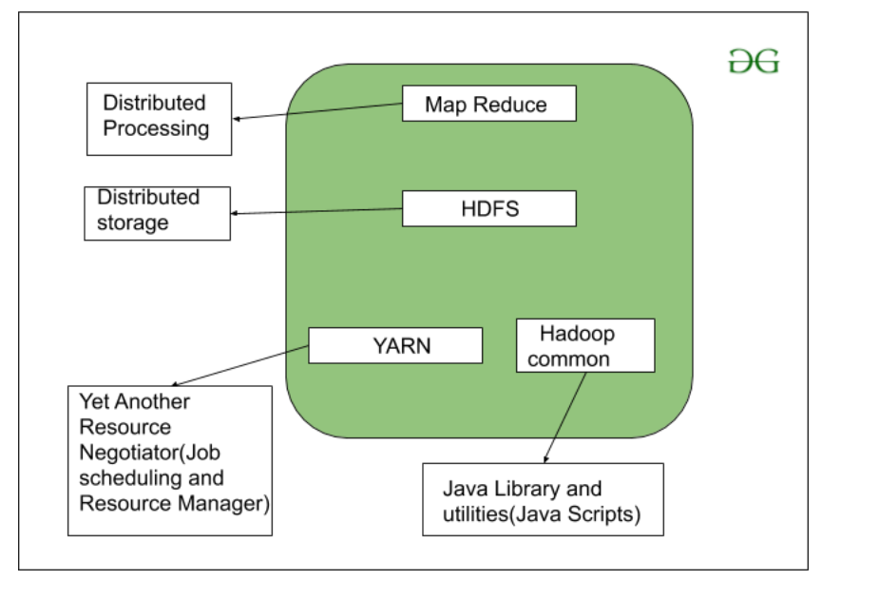

Slide 11
1. MapReduce
MapReduce nothing but just like an Algorithm or a data structure that is based on the YARN framework.
The major feature of MapReduce is to perform the distributed processing in parallel in a Hadoop cluster which Makes Hadoop working so fast.
When you are dealing with Big Data, serial processing is no more of any use.
MapReduce has mainly 2 tasks which are divided phase-wise:
In first phase, Map is utilized and in next phase Reduce is utilized.

Slide 12
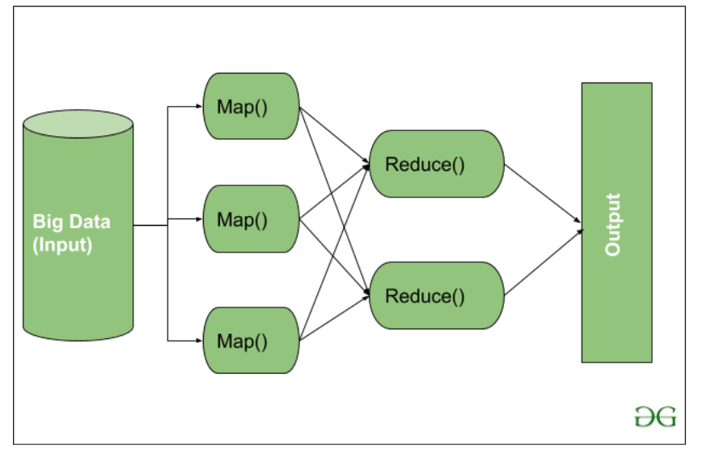

Slide 13
2. HDFS
HDFS(Hadoop Distributed File System) is utilized for storage permission.
It is mainly designed for working on commodity Hardware devices(inexpensive devices), working on a distributed file system design.
HDFS is designed in such a way that it believes more in storing the data in a large chunk of blocks rather than storing small data blocks.
HDFS in Hadoop provides Fault-tolerance and High availability to the storage layer and the other devices present in that Hadoop cluster.
Data storage Nodes in HDFS.
NameNode(Master)
DataNode(Slave)

Slide 14
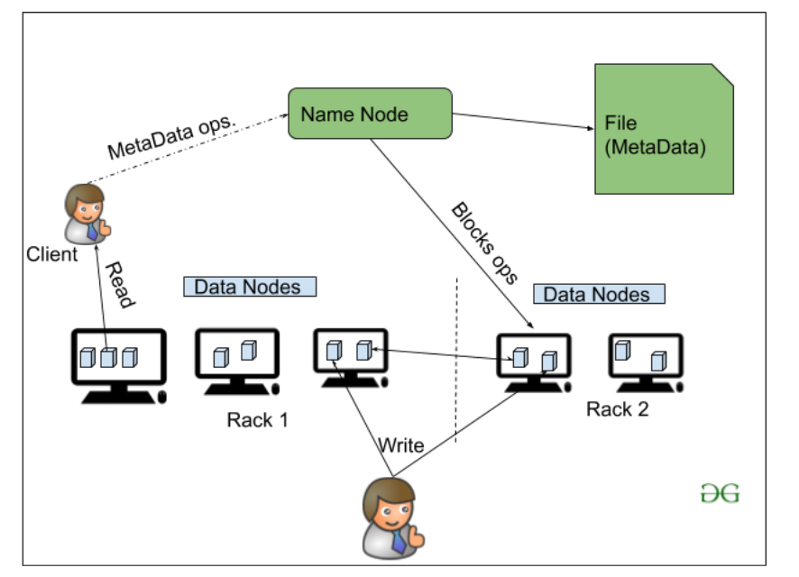

Slide 15
3. YARN(Yet Another Resource Negotiator)
YARN is a Framework on which MapReduce works.
YARN performs 2 operations that are Job scheduling and Resource Management.
The Purpose of Job schedular is to divide a big task into small jobs so that each job can be assigned to various slaves in a Hadoop cluster and Processing can be Maximized.
Job Scheduler also keeps track of which job is important, which job has more priority, dependencies between the jobs and all the other information like job timing, etc.
And the use of Resource Manager is to manage all the resources that are made available for running a Hadoop cluster.

Slide 16
Features of YARN
Multi-Tenancy-It allows multiple engine access thus giving organizations a benefit of multi-tenancy.
Scalability-The scheduler in Resource manager of YARN architecture allows Hadoop to extend and manage thousands of nodes and clusters.
Cluster-Utilization-Since YARN supports Dynamic utilization of cluster in Hadoop, which enables optimized Cluster Utilization.
Compatibility-YARN supports the existing map-reduce applications without disruptions thus making it compatible with Hadoop 1.0 as well.

Slide 17
4. Hadoop common or Common Utilities
Hadoop common or Common utilities are nothing but our java library and java files or we can say the java scripts that we need for all the other components present in a Hadoop cluster.
these utilities are used by HDFS, YARN, and MapReduce for running the cluster.
Hadoop Common verify that Hardware failure in a Hadoop cluster is common so it needs to be solved automatically in software by Hadoop Framework.

Slide 18
HADOOP CLUSTER
The Hadoop cluster first thing we need to know is what actually cluster means.
Cluster is a collection of something, a simple computer cluster is a group of various computers that are connected with each other through LAN(Local Area Network), the nodes in a cluster share the data, work on the same task and this nodes are good enough to work as a single unit means all of them to work together.

Slide 19
A Hadoop cluster is also a collection of various commodity hardware(devices that are inexpensive and amply available).
This Hardware components work together as a single unit. In the Hadoop cluster, there are lots of nodes (can be computer and servers) contains Master and Slaves, the Name node and Resource Manager works as Master and data node, and Node Manager works as a Slave.
The purpose of Master nodes is to guide the slave nodes in a single Hadoop cluster.

Slide 20
We design Hadoop clusters for storing, analyzing, understanding, and for finding the facts that are hidden behind the data or datasets which contain some crucial information.
The Hadoop cluster stores different types of data and processes them.

Slide 21
Structured-Data: The data which is well structured like Mysql.
Semi-Structured Data: The data which has the structure but not the data type like XML, Json (Javascript object notation).
Unstructured Data: The data that doesn’t have any structure like audio, video.

Slide 22
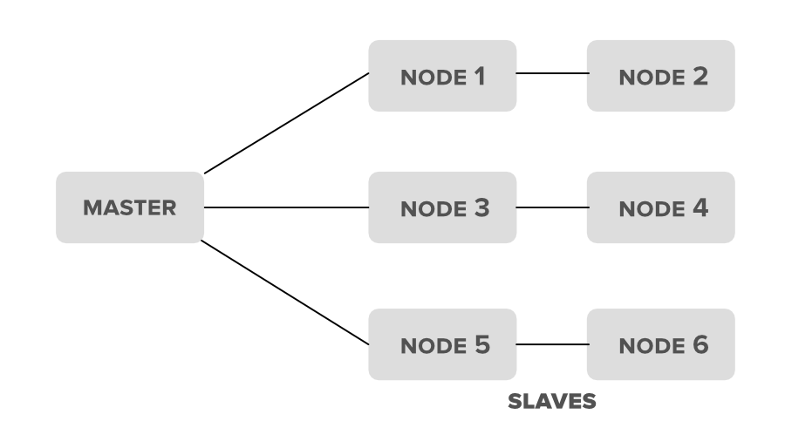

Slide 23
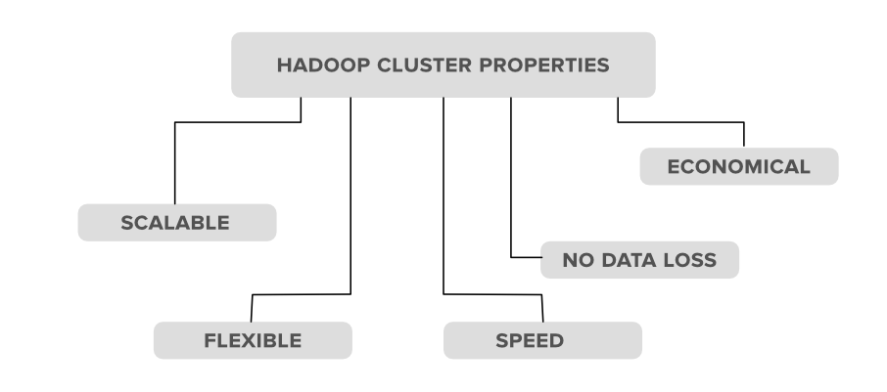
Hadoop Clusters Properties

Slide 24
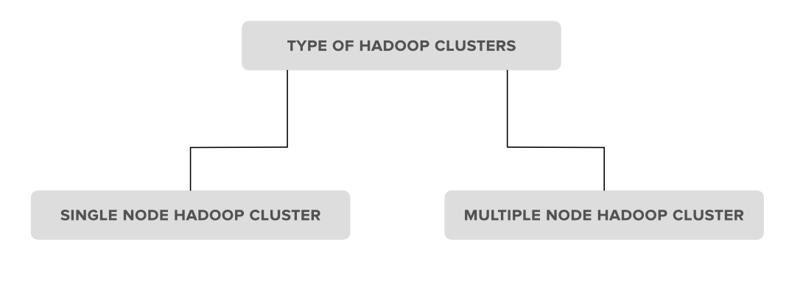
Types of Hadoop clusters 1. Single Node Hadoop Cluster 2. Multiple Node Hadoop Cluster

Slide 25
1. Single Node Hadoop Cluster
In Single Node Hadoop Cluster as the name suggests the cluster is of an only single node which means all our Hadoop Daemons i.e. Name Node, Data Node, Secondary Name Node, Resource Manager, Node Manager will run on the same system or on the same machine.
It also means that all of our processes will be handled by only single JVM(Java Virtual Machine) Process Instance.

Slide 26
2. Multiple Node Hadoop Cluster
In multiple node Hadoop clusters as the name suggests it contains multiple nodes.
In this kind of cluster set up all of our Hadoop Daemons, will store in different-different nodes in the same cluster setup.
In general, in multiple node Hadoop cluster setup we try to utilize our higher processing nodes for Master i.e. Name node and Resource Manager and we utilize the cheaper system for the slave Daemon’s i.e.Node Manager and Data Node.

Slide 27
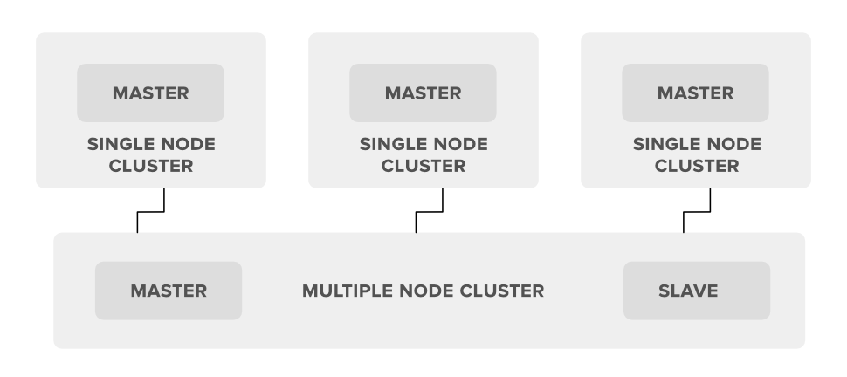

Slide 28
HDFS
HDFS(Hadoop Distributed File System) is utilized for storage permission is a Hadoop cluster.
It mainly designed for working on commodity Hardware devices(devices that are inexpensive), working on a distributed file system design.
HDFS is designed in such a way that it believes more in storing the data in a large chunk of blocks rather than storing small data blocks.
HDFS in Hadoop provides Fault-tolerance and High availability to the storage layer and the other devices present in that Hadoop cluster.

Slide 29
HDFS is capable of handling larger size data with high volume velocity and variety makes Hadoop work more efficient and reliable with easy access to all its components.
HDFS stores the data in the form of the block where the size of each data block is 128MB in size which is configurable means you can change it according to your requirement in hdfs-site.xml file in your Hadoop directory.

Slide 30
Some Important Features of HDFS(Hadoop Distributed File System)
It’s easy to access the files stored in HDFS.
HDFS also provides high availability and fault tolerance.
Provides scalability to scaleup or scaledown nodes as per our requirement.
Data is stored in distributed manner i.e. various Datanodes are responsible for storing the data.
HDFS provides Replication because of which no fear of Data Loss.
HDFS Provides High Reliability as it can store data in a large range of Petabytes.
HDFS has in-built servers in Name node and Data Node that helps them to easily retrieve the cluster information.
Provides high throughput.

Slide 31
HDFS Storage
Hadoop works on the MapReduce algorithm which is a master-slave architecture, HDFS has NameNode and DataNode that works in the similar pattern.
1. NameNode(Master) 2. DataNode(Slave)

Slide 32
1. NameNode: NameNode works as a Master in a Hadoop cluster that Guides the Datanode(Slaves).
Namenode is mainly used for storing the Metadata i.e. nothing but the data about the data.
Meta Data can be the transaction logs that keep track of the user’s activity in a Hadoop cluster.
Meta Data can also be the name of the file, size, and the information about the location(Block number, Block ids) of Datanode that Namenode stores to find the closest DataNode for Faster Communication.
Namenode instructs the DataNodes with the operation like delete, create, Replicate, etc.

Slide 33
As our NameNode is working as a Master it should have a high RAM or Processing power in order to Maintain or Guide all the slaves in a Hadoop cluster.
Namenode receives heartbeat signals and block reports from all the slaves i.e. DataNodes.

Slide 34
2. DataNode: DataNodes works as a Slave DataNodes are mainly utilized for storing the data in a Hadoop cluster, the number of DataNodes can be from 1 to 500 or even more than that, the more number of DataNode your Hadoop cluster has More Data can be stored.
so it is advised that the DataNode should have High storing capacity to store a large number of file blocks. Datanode performs operations like creation, deletion, etc. according to the instruction provided by the NameNode.

Slide 35
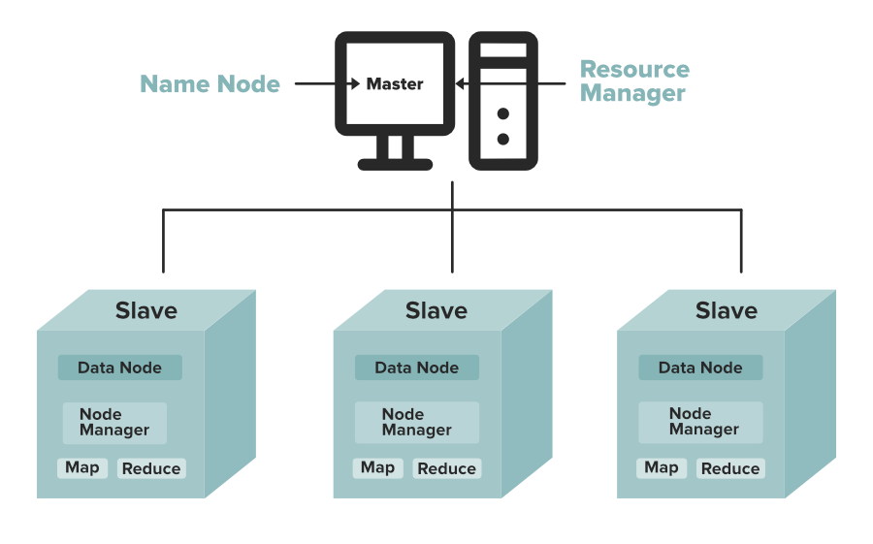

Slide 36
Objectives and Assumptions Of HDFS
1. System Failure: As a Hadoop cluster is consists of Lots of nodes with are commodity hardware so node failure is possible, so the fundamental goal of HDFS figure out this failure problem and recover it.
2. Maintaining Large Dataset: As HDFS Handle files of size ranging from GB to PB, so HDFS has to be cool enough to deal with these very large data sets on a single cluster.
3. Moving Data is Costlier then Moving the Computation: If the computational operation is performed near the location where the data is present then it is quite faster and the overall throughput of the system can be increased along with minimizing the network congestion which is a good assumption.

Slide 37
0
4. Portable Across Various Platform: HDFS Posses portability which allows it to switch across diverse Hardware and software platforms.
5. Simple Coherency Model: A Hadoop Distributed File System needs a model to write once read much access for Files. A file written then closed should not be changed, only data can be appended. This assumption helps us to minimize the data coherency issue. MapReduce fits perfectly with such kind of file model.
6. Scalability: HDFS is designed to be scalable as the data storage requirements increase over time. It can easily scale up or down by adding or removing nodes to the cluster. This helps to ensure that the system can handle large amounts of data without compromising performance.

Slide 38
7. Security: HDFS provides several security mechanisms to protect data stored on the cluster. It supports authentication and authorization mechanisms to control access to data, encryption of data in transit and at rest, and data integrity checks to detect any tampering or corruption.
8. Data Locality: HDFS aims to move the computation to where the data resides rather than moving the data to the computation. This approach minimizes network traffic and enhances performance by processing data on local nodes.

Slide 39
9. Cost-Effective: HDFS can run on low-cost commodity hardware, which makes it a cost-effective solution for large-scale data processing. Additionally, the ability to scale up or down as required means that organizations can start small and expand over time, reducing upfront costs.
10. Support for Various File Formats: HDFS is designed to support a wide range of file formats, including structured, semi-structured, and unstructured data. This makes it easier to store and process different types of data using a single system, simplifying data management and reducing costs.

Slide 40
WORKING WITH DFS
HDFS is based on master-slave architecture.
It can consist of hundreds or thousands of servers.
Applications such as SQoop, NIFI, and Kafka Connect write data to HDFS.
The client communicates with the NameNode for metadata, and the NameNode replies with the location of blocks, the number of replicas, and other attributes.

Slide 41
NameNode sends the High Availability Configuration information to Zookeeper, and it replicates the information to multiple Zookeepers.
Zookeepers serve as an election commissioner by selecting one StandBy NameNode when an Active NameNode is down, and there are multiple StandBy NameNodes.
Using NameNode information, the client contacts the DataNode directly.
Based on the information received from the NameNode, the client will start writing data directly to data nodes and reading data from the DataNodes in parallel.

Slide 42
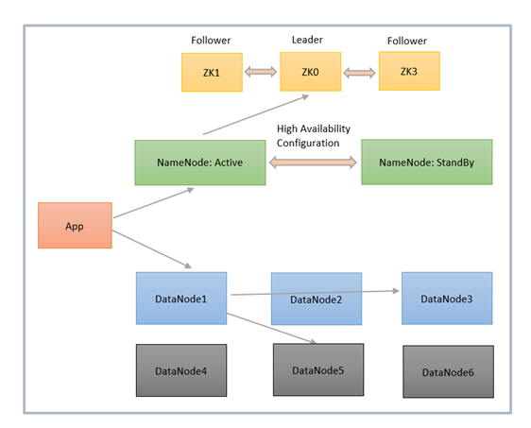
parallel.

Slide 43
HDFS Data Replication
Data replication is crucial because it ensures data remains available even if one or more nodes fail.
Data is divided into blocks in a cluster and replicated across numerous nodes.
In this case, if one node goes down, the user can still access the data on other machines.
HDFS maintains its replication process periodically.

Slide 44
Applications of HDFS
Electric companies
Marketing
Oil and gas companies

Slide 45
Map Reduce in Hadoop
One of the three components of Hadoop is Map Reduce.
The first component of Hadoop that is, Hadoop Distributed File System (HDFS) is responsible for storing the file.
The second component that is, Map Reduce is responsible for processing the file.
MapReduce has mainly 2 tasks which are divided phase-wise.
In first phase, Map is utilised and in next phase Reduce is utilised.

Slide 46
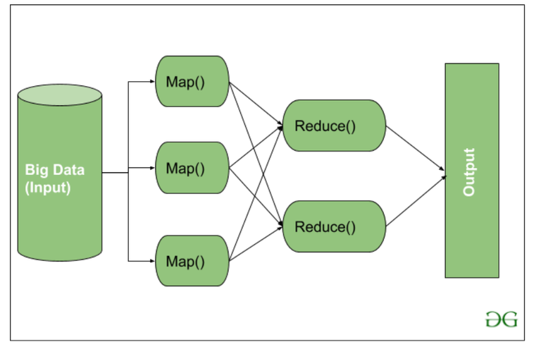

Slide 47
Steps in Map Reduce
The map takes data in the form of pairs and returns a list of <key, value> pairs.
The keys will not be unique in this case.
Using the output of Map, sort and shuffle are applied by the Hadoop architecture.
This sort and shuffle acts on these list of <key, value> pairs and sends out unique keys and a list of values associated with this unique key <key, list(values)>.
An output of sort and shuffle sent to the reducer phase.
The reducer performs a defined function on a list of values for unique keys, and Final output <key, value> will be stored/displayed.

Slide 48
sort and shuffle
The sort and shuffle occur on the output of Mapper and before the reducer.
When the Mapper task is complete, the results are sorted by key, partitioned if there are multiple reducers, and then written to disk.
Using the input from each Mapper <k2,v2>, we collect all the values for each unique key k2.
This output from the shuffle phase in the form of <k2, list(v2)> is sent as input to reducer phase.

Slide 49
Usage of MapReduce
It can be used in various application like document clustering, distributed sorting, and web link-graph reversal.
It can be used for distributed pattern-based searching.
We can also use MapReduce in machine learning.
It was used by Google to regenerate Google's index of the World Wide Web.
It can be used in multiple computing environments such as multi-cluster, multi-core, and mobile environment.

Slide 50
Hadoop YARN Architecture
YARN stands for “Yet Another Resource Negotiator“.
It was introduced in Hadoop 2.0 to remove the bottleneck on Job Tracker which was present in Hadoop 1.0.
YARN was described as a “Redesigned Resource Manager” at the time of its launching, but it has now evolved to be known as large-scale distributed operating system used for Big Data processing.

Slide 51
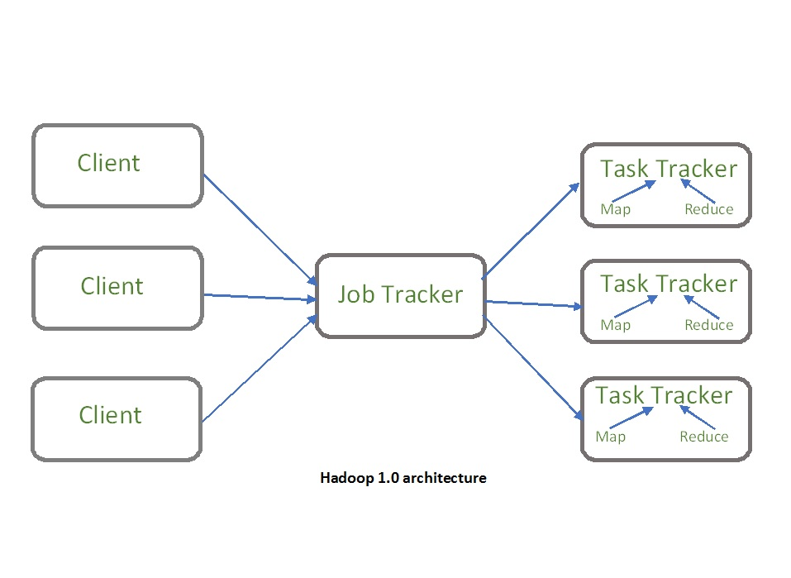

Slide 52
YARN architecture basically separates resource management layer from the processing layer.
In Hadoop 1.0 version, the responsibility of Job tracker is split between the resource manager and application manager.
YARN also allows different data processing engines like graph processing, interactive processing, stream processing as well as batch processing to run and process data stored in HDFS (Hadoop Distributed File System) thus making the system much more efficient.
Through its various components, it can dynamically allocate various resources and schedule the application processing.
For large volume data processing, it is quite necessary to manage the available resources properly so that every application can leverage them.

Slide 53
YARN Features:
Scalability: The scheduler in Resource manager of YARN architecture allows Hadoop to extend and manage thousands of nodes and clusters.
Compatibility: YARN supports the existing map-reduce applications without disruptions thus making it compatible with Hadoop 1.0 as well.
Cluster Utilization:Since YARN supports Dynamic utilization of cluster in Hadoop, which enables optimized Cluster Utilization.
Multi-tenancy: It allows multiple engine access thus giving organizations a benefit of multi-tenancy.

Slide 54
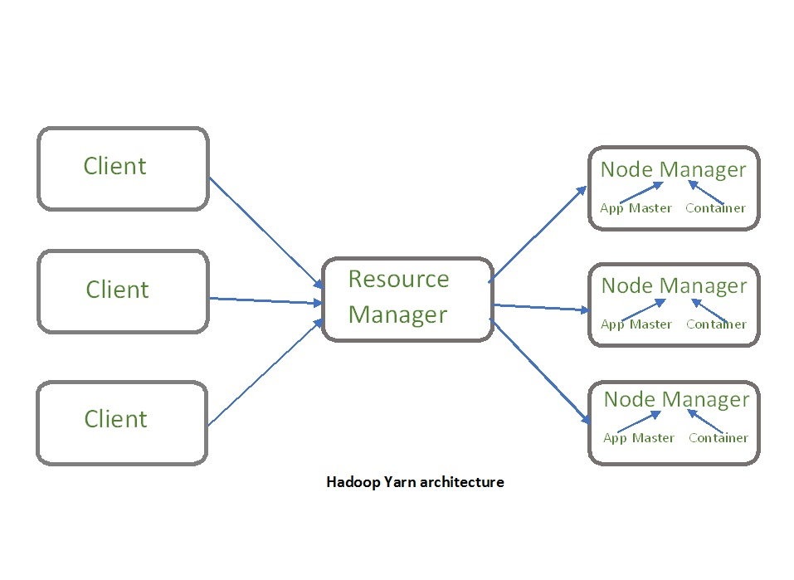

Slide 55
The main components of YARN architecture include:
Client: It submits map-reduce jobs.
Resource Manager: It is the master daemon of YARN and is responsible for resource assignment and management among all the applications. Whenever it receives a processing request, it forwards it to the corresponding node manager and allocates resources for the completion of the request accordingly. It has two major components:

Slide 56
Scheduler: It performs scheduling based on the allocated application and available resources.
It is a pure scheduler, means it does not perform other tasks such as monitoring or tracking and does not guarantee a restart if a task fails.
The YARN scheduler supports plugins such as Capacity Scheduler and Fair Scheduler to partition the cluster resources.
Application manager: It is responsible for accepting the application and negotiating the first container from the resource manager.
It also restarts the Application Master container if a task fails.

Slide 57
Node Manager: It take care of individual node on Hadoop cluster and manages application and workflow and that particular node. Its primary job is to keep-up with the Resource Manager. It registers with the Resource Manager and sends heartbeats with the health status of the node. It monitors resource usage, performs log management and also kills a container based on directions from the resource manager. It is also responsible for creating the container process and start it on the request of Application master.
Application Master: An application is a single job submitted to a framework. The application master is responsible for negotiating resources with the resource manager, tracking the status and monitoring progress of a single application. The application master requests the container from the node manager by sending a Container Launch Context(CLC) which includes everything an application needs to run. Once the application is started, it sends the health report to the resource manager from time-to-time.

Slide 58
Container: It is a collection of physical resources such as RAM, CPU cores and disk on a single node. The containers are invoked by Container Launch Context(CLC) which is a record that contains information such as environment variables, security tokens, dependencies etc.

Slide 59
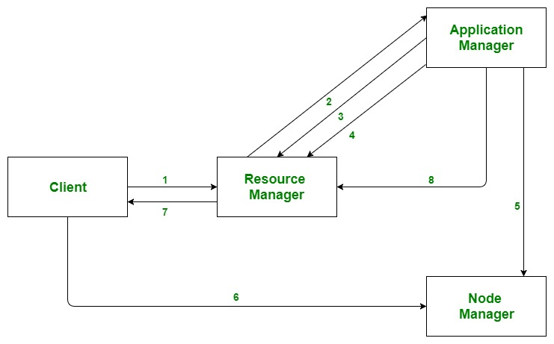
Application workflow in Hadoop YARN:

Slide 60
Client submits an application
The Resource Manager allocates a container to start the Application Manager
The Application Manager registers itself with the Resource Manager
The Application Manager negotiates containers from the Resource Manager
The Application Manager notifies the Node Manager to launch containers
Application code is executed in the container
Client contacts Resource Manager/Application Manager to monitor application’s status
Once the processing is complete, the Application Manager un-registers with the Resource Manager

Slide 61
Advantages :
Flexibility
Resource Management
Scalability
Improved Performance
Security

Slide 62
Disadvantages :
Complexity: YARN adds complexity to the Hadoop ecosystem. It requires additional configurations and settings, which can be difficult for users who are not familiar with YARN.
Overhead: YARN introduces additional overhead, which can slow down the performance of the Hadoop cluster. This overhead is required for managing resources and scheduling applications.
Latency: YARN introduces additional latency in the Hadoop ecosystem. This latency can be caused by resource allocation, application scheduling, and communication between components.
Single Point of Failure: YARN can be a single point of failure in the Hadoop cluster. If YARN fails, it can cause the entire cluster to go down. To avoid this, administrators need to set up a backup YARN instance for high availability.
Limited Support: YARN has limited support for non-Java programming languages. Although it supports multiple processing engines, some engines have limited language support, which can limit the usability of YARN in certain environments.

Slide 63
Spark
Apache Spark is an open-source tool.
It is a newer project, initially developed in 2012, at the AMPLab at UC Berkeley.
It is focused on processing data in parallel across a cluster, but the biggest difference is that it works in memory.
It is designed to use RAM for caching and processing the data. Spark performs different types of big data workloads like:
Batch processing.
Real-time stream processing.
Machine learning.
Graph computation.
Interactive queries.

Slide 64
There are five main components of Apache Spark:
Apache Spark Core: It is responsible for functions like scheduling, input and output operations, task dispatching, etc.
Spark SQL: This is used to gather information about structured data and how the data is processed.
Spark Streaming: This component enables the processing of live data streams.
Machine Learning Library: The goal of this component is scalability and to make machine learning more accessible.
GraphX: This has a set of APIs that are used for facilitating graph analytics tasks.

Slide 65
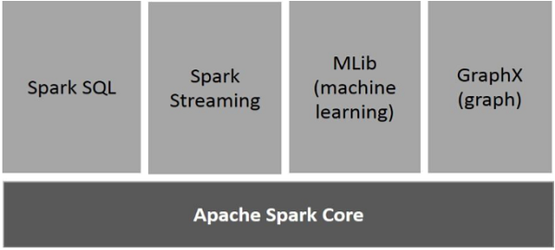
Components of Spark

Slide 66
Apache Spark Core
Spark Core is the underlying general execution engine for spark platform that all other functionality is built upon.
It provides In-Memory computing and referencing datasets in external storage systems.
Spark SQL
Spark SQL is a component on top of Spark Core that introduces a new data abstraction called SchemaRDD, which provides support for structured and semi-structured data.

Slide 67
Spark Streaming
Spark Streaming leverages Spark Core's fast scheduling capability to perform streaming analytics.
It ingests data in mini-batches and performs RDD (Resilient Distributed Datasets) transformations on those mini-batches of data.
MLlib (Machine Learning Library)
MLlib is a distributed machine learning framework above Spark because of the distributed memory-based Spark architecture.
It is, according to benchmarks, done by the MLlib developers against the Alternating Least Squares (ALS) implementations.
Spark MLlib is nine times as fast as the Hadoop disk-based version of Apache Mahout (before Mahout gained a Spark interface).

Slide 68
GraphX
GraphX is a distributed graph-processing framework on top of Spark.
It provides an API for expressing graph computation that can model the user-defined graphs by using Pregel abstraction API.
It also provides an optimized runtime for this abstraction.

Slide 69
Advantage of Spark:
Perfect for interactive processing, iterative processing and event stream processing
Flexible and powerful
Supports for sophisticated analytics
Executes batch processing jobs faster than MapReduce
Run on Hadoop alongside other tools in the Hadoop ecosystem

Slide 70
Disadvantage of Spark:
Consumes a lot of memory
Issues with small file
Less number of algorithms
Higher latency compared to Apache fling

Slide 71
Below is a table of differences between Hadoop and Spark:
Basis | Hadoop | Spark
Processing Speed & Performance | Hadoop’s MapReduce model reads and writes from a disk, thus slowing down the processing speed. | Spark reduces the number of read/write cycles to disk and stores intermediate data in memory, hence faster-processing speed.
Usage | Hadoop is designed to handle batch processing efficiently. | Spark is designed to handle real-time data efficiently.

Slide 72
Data | With Hadoop MapReduce, a developer can only process data in batch mode only. | Spark can process real-time data, from real-time events like Twitter, and Facebook.
Cost | Hadoop is a cheaper option available while comparing it in terms of cost | Spark requires a lot of RAM to run in-memory, thus increasing the cluster and hence cost.
Algorithm Used | The PageRank algorithm is used in Hadoop. | Graph computation library called GraphX is used by Spark.
Fault Tolerance | Hadoop is a highly fault-tolerant system where Fault-tolerance achieved by replicating blocks of data. If a node goes down, the data can be found on another node | Fault-tolerance achieved by storing chain of transformations If data is lost, the chain of transformations can be recomputed on the original data
Security | Hadoop supports LDAP, ACLs, SLAs, etc and hence it is extremely secure. | Spark is not secure, it relies on the integration with Hadoop to achieve the necessary security level.

Slide 73
Scalability | Hadoop is easily scalable by adding nodes and disk for storage. It supports tens of thousands of nodes. | It is quite difficult to scale as it relies on RAM for computations. It supports thousands of nodes in a cluster.
Language support | It uses Java or Python for MapReduce apps. | It uses Java, R, Scala, Python, or Spark SQL for the APIs.
User-friendliness | It is more difficult to use. | It is more user-friendly.
Resource Management | YARN is the most common option for resource management. | It has built-in tools for resource management.

Slide 74
RDD
The RDD (Resilient Distributed Dataset) is the Spark's core abstraction.
It is a collection of elements, partitioned across the nodes of the cluster so that we can execute various parallel operations on it.
There are two ways to create RDDs:
Parallelizing an existing data in the driver program
Referencing a dataset in an external storage system, such as a shared filesystem, HDFS, HBase, or any data source offering a Hadoop InputFormat.

Slide 75
RDD stands for Resilient Distributed Dataset, these are the elements that run and operate on multiple nodes to do parallel processing on a cluster.
RDDs are immutable elements, which means once you create an RDD you cannot change it.
RDDs are fault tolerant as well, hence in case of any failure, they recover automatically.
You can apply multiple operations on these RDDs to achieve a certain task.

Slide 76
To apply operations on these RDD's, there are two ways − Transformation and Action
Transformation − These are the operations, which are applied on a RDD to create a new RDD. Filter, groupBy and map are the examples of transformations.
Action − These are the operations that are applied on RDD, which instructs Spark to perform computation and send the result back to the driver.

Slide 77
There are two ways to create RDDs − parallelizing an existing collection in your driver program, or referencing a dataset in an external storage system, such as a shared file system, HDFS, HBase, or any data source offering a Hadoop Input Format.

Slide 78
Parallelized Collections
To create parallelized collection, call SparkContext's parallelize method on an existing collection in the driver program.
Each element of collection is copied to form a distributed dataset that can be operated on in parallel.

Slide 79
External Datasets
In Spark, the distributed datasets can be created from any type of storage sources supported by Hadoop such as HDFS, Cassandra, HBase and even our local file system. Spark provides the support for text files, SequenceFiles, and other types of Hadoop InputFormat.
SparkContext's textFile method can be used to create RDD's text file.
This method takes a URI for the file (either a local path on the machine or a hdfs://) and reads the data of the file.
Spark makes use of the concept of RDD to achieve faster and efficient MapReduce operations.

Slide 80
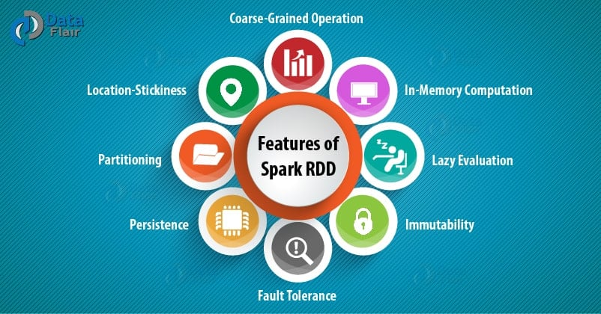
Features of Spark RDD

Slide 81
i. In-memory Computation
Spark RDDs have a provision of in-memory computation. It stores intermediate results in distributed memory(RAM) instead of stable storage(disk).
ii. Lazy Evaluations
All transformations in Apache Spark are lazy, in that they do not compute their results right away. Instead, they just remember the transformations applied to some base data set.
Spark computes transformations when an action requires a result for the driver program. Follow this guide for the deep study of Spark Lazy Evaluation.

Slide 82
iii. Fault Tolerance
Spark RDDs are fault tolerant as they track data lineage information to rebuild lost data automatically on failure. They rebuild lost data on failure using lineage, each RDD remembers how it was created from other datasets (by transformations like a map, join or groupBy) to recreate itself. Follow this guide for the deep study of RDD Fault Tolerance.
iv. Immutability
Data is safe to share across processes. It can also be created or retrieved anytime which makes caching, sharing & replication easy. Thus, it is a way to reach consistency in computations.

Slide 83
v. Partitioning
Partitioning is the fundamental unit of parallelism in Spark RDD. Each partition is one logical division of data which is mutable. One can create a partition through some transformations on existing partitions.
vi. Persistence
Users can state which RDDs they will reuse and choose a storage strategy for them (e.g., in-memory storage or on Disk).
vii. Coarse-grained Operations
It applies to all elements in datasets through maps or filter or group by operation.
viii. Location-Stickiness
RDDs are capable of defining placement preference to compute partitions. Placement preference refers to information about the location of RDD. The DAGScheduler places the partitions in such a way that task is close to data as much as possible.

Slide 84
Storing and Querying Data.
Storing and Querying Data in Hadoop and Spark
In the Hadoop ecosystem, storing and querying data efficiently is crucial for handling large-scale datasets. Below is an overview of how data storage and querying work in both Hadoop and Spark.
1. Storing Data
Data storage in Hadoop is primarily handled by HDFS (Hadoop Distributed File System), while Spark relies on both HDFS and other distributed storage systems.

Slide 85
A. Hadoop Distributed File System (HDFS)
HDFS is a distributed storage system that stores data across multiple machines in a Hadoop cluster.
It follows a Master-Slave Architecture:
NameNode (Master) manages metadata (directory structure, file permissions, and block locations).
DataNodes (Slaves) store actual data blocks.
Files are divided into blocks (default 128MB or 256MB) and replicated across multiple nodes for fault tolerance.
HDFS supports batch processing and is optimized for large files (not small files).

Slide 86
B. Other Storage Options in Hadoop and Spark
Apache HBase: A NoSQL database for real-time read/write access to large datasets.
Apache Hive: A data warehouse that stores structured data and allows SQL-like querying.
Apache ORC and Parquet: Columnar storage formats that optimize storage and query performance.
Amazon S3, Google Cloud Storage, and Azure Blob Storage: Cloud-based storage options that integrate with Hadoop and Spark.

Slide 87
2. Querying Data
Querying data in the Hadoop ecosystem can be done using different tools depending on the use case:
A. Querying in Hadoop
Apache Hive
SQL-like querying language called HiveQL.
Converts queries into MapReduce, Tez, or Spark jobs.
Best suited for batch processing of structured data.

Slide 88
Apache Pig
A high-level scripting language (Pig Latin) for data transformation.
Converts Pig scripts into MapReduce jobs.
Apache HBase
NoSQL database with fast read/write operations.
Supports key-value lookups but does not support SQL natively.

Slide 89
B. Querying in Spark
Spark SQL
Allows querying structured data using SQL and DataFrames.
Supports JDBC/ODBC for database connectivity.
Can read from multiple sources: HDFS, Hive, Parquet, JSON, and relational databases.
RDD (Resilient Distributed Dataset) Queries
Provides transformations (map, filter, reduceByKey) for querying unstructured data.
Less optimized than DataFrames or Spark SQL but gives more control.
DataFrames and Datasets
More efficient than RDDs.
Uses Catalyst Optimizer for query optimization.
Spark Streaming
Allows querying real-time data streams from Kafka, Flume, and other sources.

Slide 90
Comparison: Hadoop vs. Spark for Storing & Querying
Feature | Hadoop (HDFS, Hive) | Spark (RDD, DataFrames, SQL)
Storage | HDFS (Batch-oriented) | HDFS, S3, HBase, Parquet
Query Language | HiveQL, Pig Latin | SQL, DataFrames, RDD transformations
Speed | Slower (MapReduce-based) | Faster (In-memory processing)
Use Case | Large-scale batch processing | Real-time & batch processing

Slide 91
Conclusion
HDFS is the core storage system in Hadoop, but other storage solutions like HBase, ORC, and Parquet are also used.
Querying in Hadoop is mainly done through Hive, Pig, and HBase.
Spark SQL and DataFrames provide an efficient way to query data with better performance than traditional MapReduce.

Slide 92
Thank You..

